Slide 1
Microsoft Bot Framework V4 Assignment

Slide 2
Agenda
Microsoft Bot framework V4 concept
Architecture
Services involved
Usecase
Chat screenshots

Slide 3
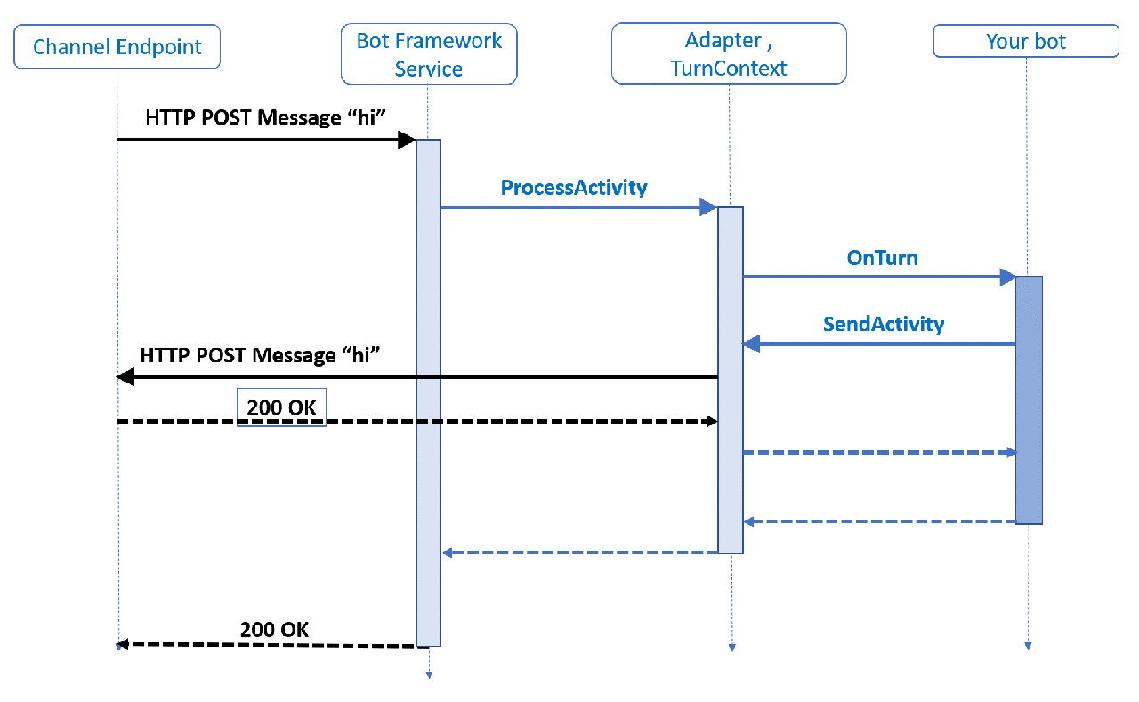
Microsoft Bot framework V4 concept

Slide 4
Architecture
LUIS
Bing Spell Check
Spell correction
Intent recognition
Microsoft Bot Framework
User interface
utterances
CosmosDB
Logging data
Analytics
Application Insight

Slide 5
Services Involved
Microsoft Bot Framework
Microsoft LUIS
Microsoft Bing Spell Check
Microsoft Application Insight

Slide 6
Usecase
Users can use bot to book cab. This bot can be used either by providing the utterances or clicking on the “Book a cab” button.
User can type following utterance to invoke the bot “Book a cab”

Slide 7
Chat script – Cab Booking
Welcome to the Cab booking Bot!. How can I help you today?
 | Book a cab
From where are you traveling?
 | delhi
To where are you traveling?
 | noida
What kind of cab you want?
 | Sedan
When are you leaving?
 | today 10 pm
your sedan cab is confirmed delhi to noida on today 10 pm

Slide 8
Chat script – Cab Cancel
Welcome to the Cab booking Bot!. How can I help you today?
 | Cancel my ride
Your cab is canceled!

Slide 9
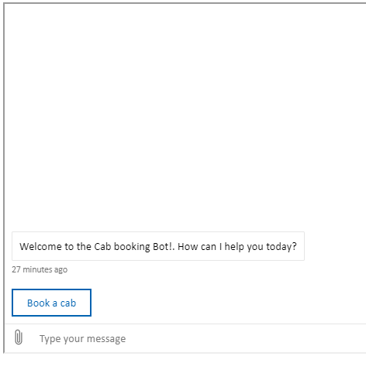
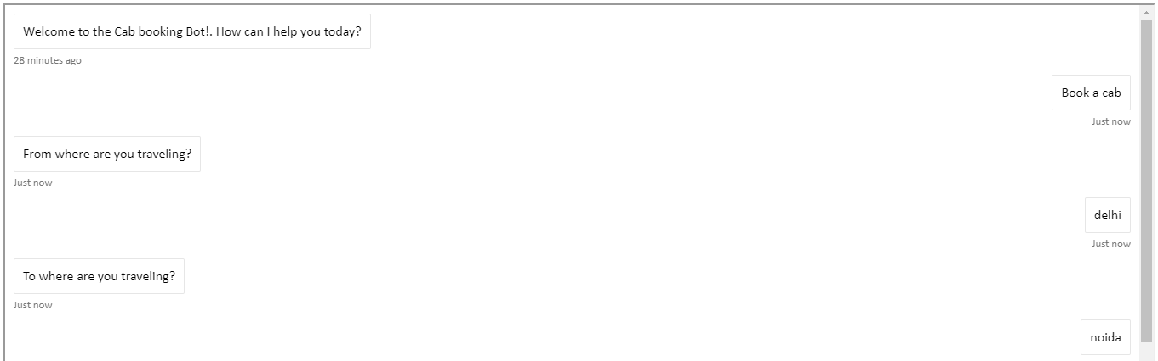
Screenshots
Screen:-2
Screen:-1

Slide 10
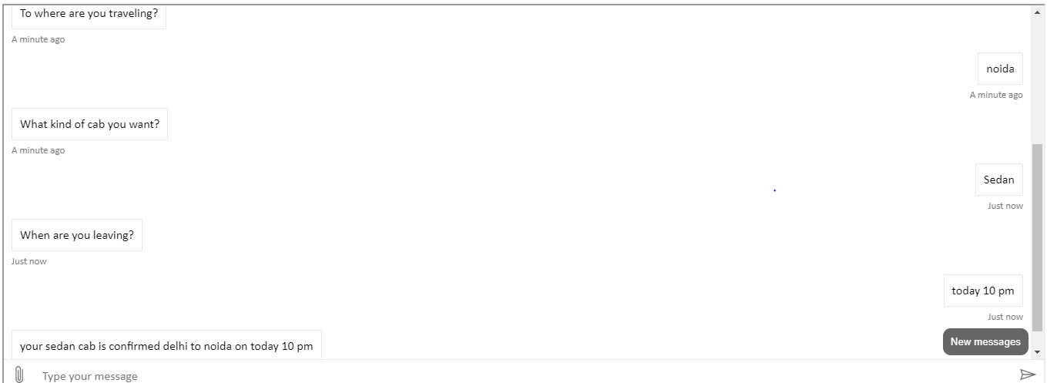
Screenshots
Screen:-3

Slide 11
THANK YOU

